Slide 1

All of Us
Fred LaPolla, MLS
12/18/2025

Slide 2
Outcomes
Participants will be able to….
…describe the All of Us Research Program
…identify steps needed to apply for access
…explore the public data browser

Slide 3



Please download and install the Slido app on all computers you use
Have you heard of All of Us before
ⓘ Start presenting to display the poll results on this slide.

Slide 4

Please download and install the Slido app on all computers you use
What domains interest you for research?
ⓘ Start presenting to display the poll results on this slide.

Slide 5
Please download and install the Slido app on all computers you use
What is your comfort level with statistical coding (Python, R, Sas)?
ⓘ Start presenting to display the poll results on this slide.

Slide 6
All of Us
  Began by the NIH based on a report from the Precision Medicine Initiative Working Group of the Advisory Committee to the Director in March 2015
  Aims to enroll 1 million participants reflecting the diversity of the US
  Includes surveys, health data streams (EHR data), genomic data, environmental data, and physical measurements

Slide 7
All of Us Core Values
  Openness
  Diversity
  Partnership with Participants
  Transparence
  Patient Access to Information
  Access for Research
  Security and Privacy
  Positive Change

Slide 8
All of Us Data Types
  EHR data – Long form data about study participants health record, including conditions observed, prescriptions and diagnoses
  Genomic data - DNA information including short and long read whole genome sequencing data and mircorarray data (controlled tier only)
  Survey data – Information ranging from health behaviors to experiences of healthcare discrimination
  Physical Measurements – Data such as height, weight, and blood pressure
  Wearables – Biometric data (controlled tier only)

Slide 9
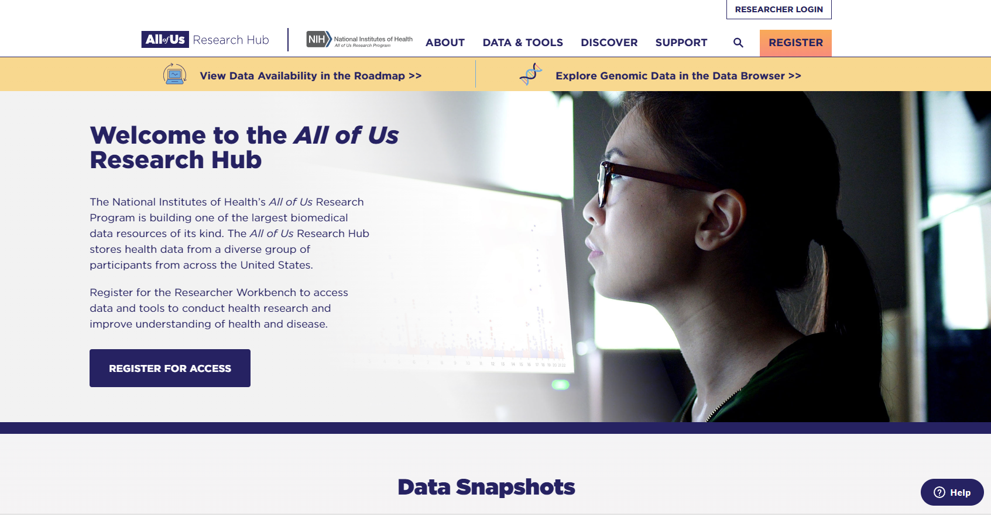
Accessing All of Us Program Data
  All of Us Research Hub (researchallofus.org)

Slide 10
Please download and install the Slido app on all computers you use
What specific conditions would you like to explore?
ⓘ Start presenting to display the poll results on this slide.

Slide 11
Please download and install the Slido app on all computers you use
For the condition you explored, how many participants were described in the data (write condition and number)?
ⓘ Start presenting to display the poll results on this slide.

Slide 12
Accessing All of Us Program Data
  Three tiers of data
  Public data browser: aggregated data only, no ability to cross tabulate
  Researcher Workbench access: deidentified data about participants in the study
  Controlled Tier: Genomic, phenome and certain surveys

Slide 13
Accessing All of Us Program Data Requirements
  Data must be accessed within the All of Us Researcher Data Browser and cannot be exported (figures and descriptive statistics can be included in papers).
  Users create queries of the massive database to make a subset, called a Workspace, to work with in the Data Browser.
  Users can analyze in R, Python or Sas, using a Jupyter notebook or an RStudio cloud instance.
  When creating an account, users’ accounts are credited $300 and maintaining the workspaces depletes a small amount per month.

Slide 14
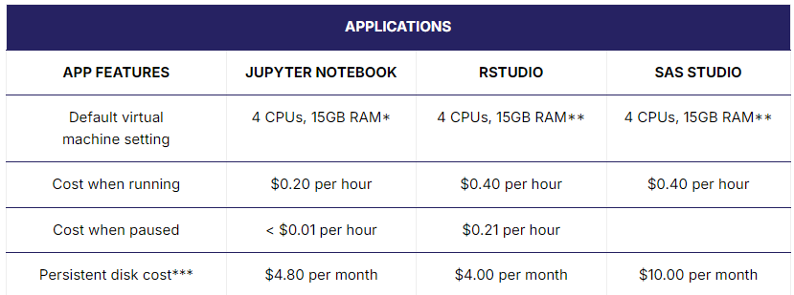
Accessing All of Us Program Data Requirements
  https://support.researchallofus.org/hc/en-us/articles/360039539411-Getting-Started-and-What-to-Know-About-Costs

Slide 15
Accessing All of Us Program Limitations
  Regional specificity is lacking at the non-controlled tier
  In certain regards, notably education and income, the All of Us population does not track the US population trends, for example advanced degree holders appear to be over-represented, and income level representation does not match proportions of the US or NY population in terms of income bracket
  Requires code-based analysis techniques
  Is an opt-in system so those marginalized by health systems or lacking in physicians may not be included

Slide 16
Accessing All of Us Program Researcher Workbench
  Data Browser | All of Us Public Data Browser (researchallofus.org)

Slide 17
Accessing All of Us Program Researcher Workbench
  To work in the workbench you must first define a cohort.
  The cohort is the group you are looking at, i.e. people diagnosed with diabetes who have filled out the social determinants of health table.
  You need to consider ways to limit your cohort size, or else it will greatly slow down your ability to conduct analyses.
  Then you can include specific measures and surveys.
  Then you analyze in the All of Us Program Researcher Workbench

Slide 18
Workspace Creation

Slide 19
Workspace Creation
A detailed description of your project and aims is required
Goals of a project can be for education or research purposes
Descriptions are publicly viewable
If insufficient detail is included, All of Us staff will contact you
Projects can be exploratory or hypothesis testing in nature

Slide 20
Cohort Builder: Who

Slide 21
Defining your cohort
Defining your cohort:
Who will be included in your analysis
    e.g. People with a given condition/exposure
Essential to determine in advance
    Attempting to analyze all individuals will result in unrealistically slow analysis times
    Important to focus your research question
The cohort is not a list of all items that can be measured or modeled in your analysis

Slide 22
Defining your cohort
All of Us automatically generates the SQL
For improved experience, you will need to rename the variables assigned for each table

Slide 23
Dataset Builder: What

Slide 24
Defining your dataset
After you determine who you are analyzing, you need to determine what to ask about them:
    Condition of interest
    Outcome of interest (dependent variable)
    Demographic information
    Potential confounders
    Modifiers

Slide 25
Defining your dataset
Data to be pulled are defined in "Concept Sets"
A concept set might include clinical measures, survey data, clinical observations or medications.
A concept set will correspond to the types of data listed in the Data Browser
All of Us's analysis notebook will automatically format the SQL
As with the cohort, you will want to update the variable name

Slide 26
Analysis: Why

Slide 27
Analyzing your dataset
Once you pull your data, you will need to begin filtering the long-form EHR data for specific measures and dates, and merging tables into a wide format.
You will need to consider dates, independent and dependent variables, and any potential confounder or moderators.

Slide 28
Review

Slide 29
Please download and install the Slido app on all computers you use
True or False: Users of All of Us can download data to work with on their local computer
ⓘ Start presenting to display the poll results on this slide.

Slide 30
Please download and install the Slido app on all computers you use
A cohort in the All of Us Program Researcher Workbench is…
ⓘ Start presenting to display the poll results on this slide.

Slide 31
Please download and install the Slido app on all computers you use
True or False: All of Us is free to use for analyzing data
ⓘ Start presenting to display the poll results on this slide.

Slide 32

As NYU Researchers, you can gain access to the All of Us Research Workbench to conduct novel research on a very large dataset

Slide 33

Q&A
Supporting text and
contact information

Slide 34

Thank you
Supporting text and
contact information

Slide 35
Works Cited
Data Browser. All of Us public data browser. Accessed March 18, 2024. https://databrowser.researchallofus.org/
All of Us Research Hub. Accessed March 18, 2024. https://www.researchallofus.org/
LaPolla FWZ, Barber Grossi M, Chen S, Guo TW, Havranek K, Jebb O, Nguyen MT, Panganamamula S, Smith N, Sundaresh S, Yu J, Mayer G. All of whom? Limitations encountered using All of Us Researcher Workbench in a Primary Care residents secondary data analysis research training block. J Am Med Inform Assoc. 2024 Jun 25:ocae162. doi: 10.1093/jamia/ocae162. Epub ahead of print. PMID: 38917426.

